Slide 1
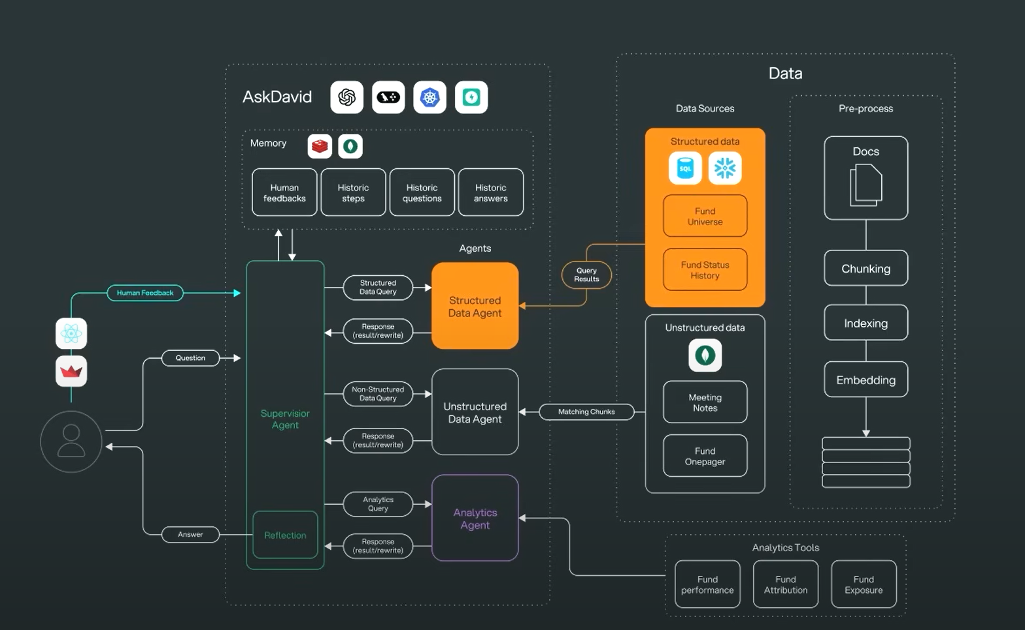
Multi Agent Architecture

Slide 2
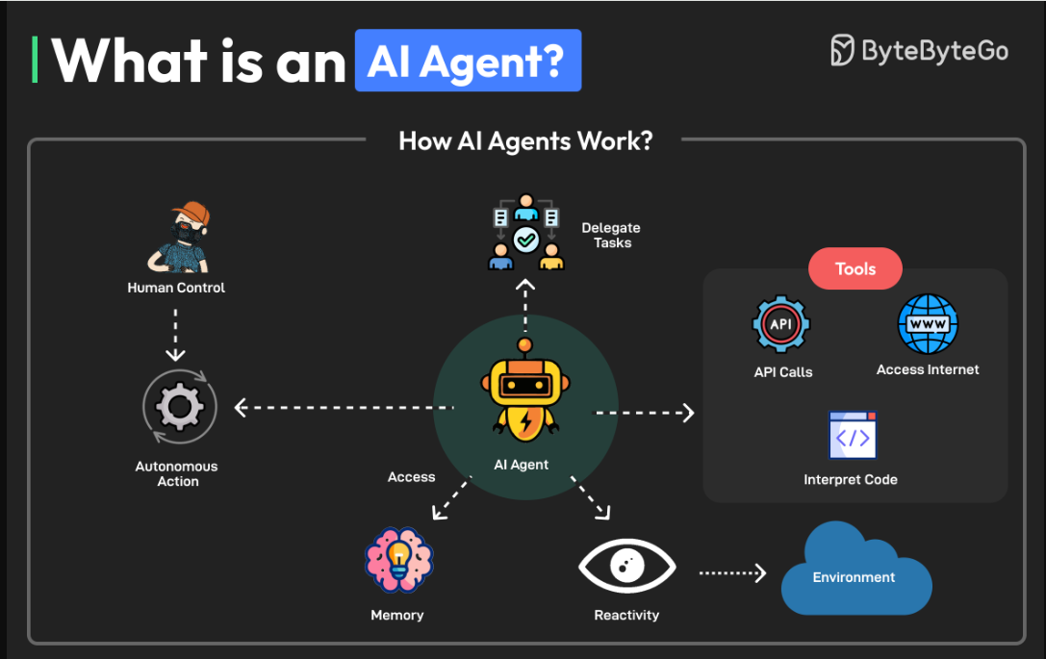
AI AGENT

Slide 3
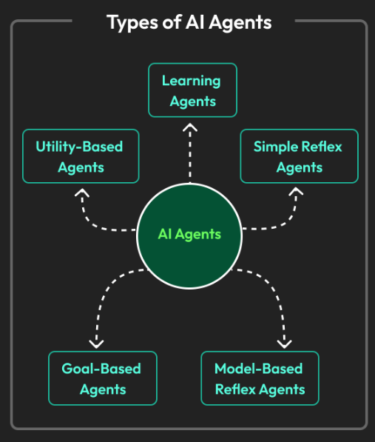
Types of AI AGENT

Slide 4
Simple Reflex Agents
Definition: Operate by mapping current percepts directly to actions, based on a set of predefined condition–action rules (“if … then …”).
Key Characteristics:
Do not maintain any internal state about the world; decisions are purely reactive to immediate inputs.
Suitable when the environment is fully observable and the correct action depends only on the current percept.
Advantages & Limitations:
Advantage: Very fast, easy to implement.
Limitation: Fail in partially observable or dynamic environments, because they cannot remember past percepts or model unseen aspects.
Example: A thermostat that switches heating on/off solely based on current temperature reading.

Slide 5
Model-Based Reflex Agents
Definition: Extend simple reflex design by maintaining an internal model (representation) of the world, tracking aspects not immediately visible in the current percept.
Key Characteristics:
Store a state variable that summarizes all relevant history.
Update the internal model with each new percept to infer unseen details.
Use condition–action rules compared against both percept and model state.
Advantages & Limitations:
Advantage: Handle partially observable environments better than simple reflex agents, since they reason about hidden state.
Limitation: Require accurate modeling of the environment and more computation to update and consult the model.
Example: A robot vacuum that remembers which rooms it has cleaned (even if it temporarily loses sensor readings).

Slide 6
Goal-Based Agents
Definition: Go further by not only modeling the world but also explicitly representing goals; they choose actions that they predict will bring about goal fulfillment.
Key Characteristics:
Maintain a representation of goals (desired states) in addition to model of current state.
Use a search or planning procedure to decide which sequence of actions will most likely achieve the goal.
Decision criterion: “Which action leads closer to the goal?”
Advantages & Limitations:
Advantage: More flexible than reflex agents; can plan ahead, consider alternatives, and handle dynamic changes.
Limitation: Planning can be computationally expensive; quality depends on accuracy of the model and goal specification.
Example: A navigation system that computes a sequence of turns and routes to reach a destination, adapting if roads close.

Slide 7
Utility-Based Agents
Definition: Augment goal-based design by incorporating a utility function that ranks different possible world states by “happiness” or “preference level.”
Key Characteristics:
Explicitly evaluate and compare how desirable each world state is, rather than simply “goal vs. non-goal.”
Choose actions to maximize expected utility, accounting for trade-offs and partial satisfaction.
Better at handling conflicting objectives (e.g., speed vs. safety).
Advantages & Limitations:
Advantage: More nuanced decision-making, especially in uncertain or multi-objective settings.
Limitation: Requires careful design of a utility function; computational overhead can be high.
Example: A self-driving car that balances safety, time-to-destination, passenger comfort, and energy efficiency when selecting a maneuver.

Slide 8
Learning Agents
Definition: Designed to improve performance over time by learning from experience, rather than relying solely on a fixed set of rules or models.
Key Components (per standard AI textbooks):
Learning Element: Adjusts the agent’s knowledge based on feedback.
Performance Element: Selects actions using current knowledge.
Critic: Provides feedback on how well the agent is doing relative to some performance standard.
Problem Generator: Suggests exploratory actions to learn new information.
Advantages & Limitations:
Advantage: Can adapt to unknown or changing environments, improve over time.
Limitation: May require large amounts of data; learning might be slow or unstable; risk of overfitting to specific patterns.
Example: A recommendation system that refines its suggestions by analyzing users’ click-through and purchase history.

Slide 9
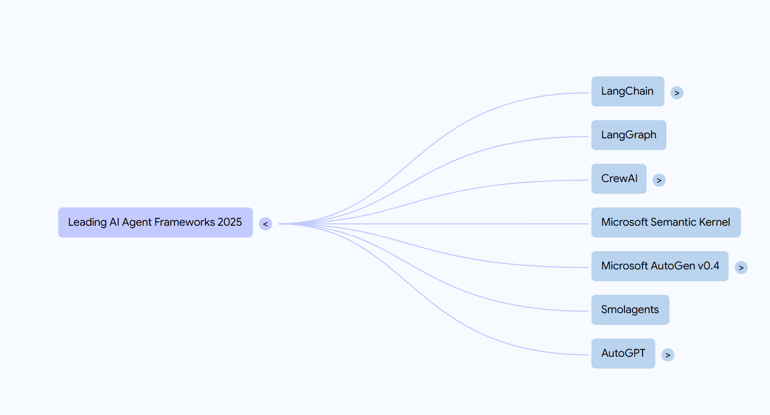
AI Agent Frameworks

Slide 10
Build and Deploy Simple AI Agent
Tech Stack Used : Langchain, FastAPI, Docker + Preferred LLM Model

Slide 11
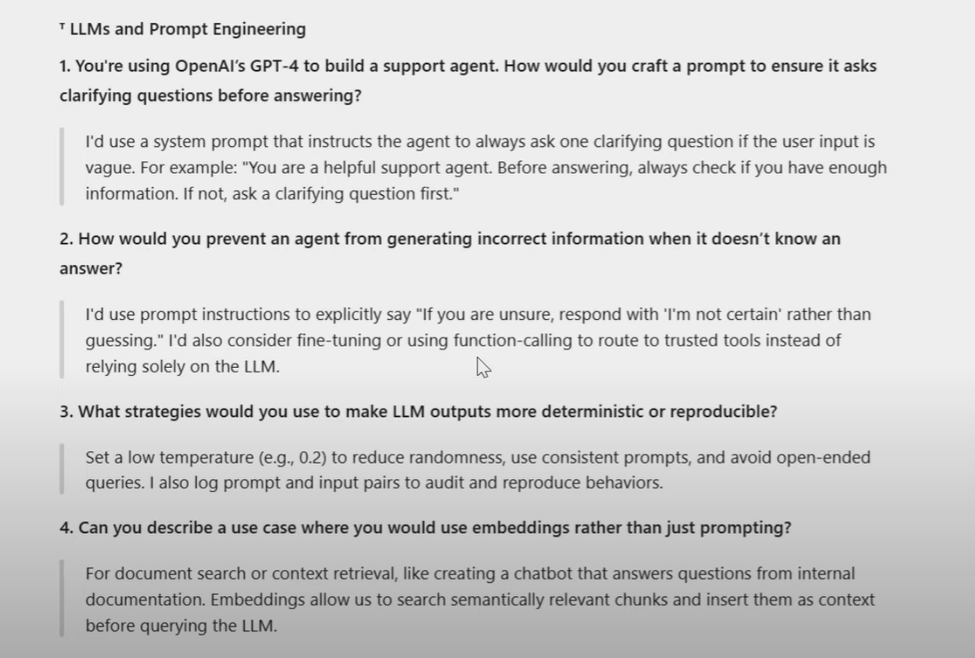

Slide 12
Crafting a Prompt That Forces Clarifying Questions
Original Answer: “I’d use a system prompt that instructs the agent to always ask one clarifying question if the user input is vague. For example: ‘You are a helpful support agent. Before answering, always check if you have enough information. If not, ask a clarifying question first.’”
Evaluation:
Correctness: Telling the model in a system prompt to check for ambiguity and ask before answering is a standard and effective strategy.
Completeness: In practice, it is helpful to include concrete examples of “vague” inputs (for instance, missing details about a device or context) so the model knows precisely when to prompt the user.
Potential Issue: Even with this instruction, some edge cases may slip through if the prompt does not define vagueness clearly. Adding sample questions such as “Which printer model and error message are you seeing?” will guide the agent more reliably.
Verdict: The answer is fundamentally correct. For production, enrich the prompt with exemplar clarifying questions and explicit criteria for uncertainty.

Slide 13
Preventing Incorrect or Fabricated Information
Original Answer: “I’d use prompt instructions to explicitly say ‘If you are unsure, respond with “I’m not certain” rather than guessing.’ I’d also consider fine‐tuning or using function‐calling to route to trusted tools instead of relying solely on the LLM.”
Evaluation:
Correctness: Instructing the model to defer when it lacks confidence is a proven technique. Fine‐tuning or invoking external tools for factual lookup further reduces hallucinations.
Enhancements: Adding guardrails like “Always prepend your answer with ‘According to my data…’ or ‘I’m not sure, but here is what I found…’” helps set expectations. You can also lower temperature, employ retrieval‐augmented generation (RAG), or require citations from a knowledge base for crucial facts.
Caveat: Simple instructions may not eliminate all hallucinations. Combining multiple layers—prompt design, modular tool calls, and confidence checks—yields more robust results.
Verdict: Correct in principle. In a real‐world system, you should layer additional verification methods to minimize incorrect outputs.

Slide 14
Making LLM Outputs More Deterministic and Reproducible
Original Answer: “Set a low temperature (e.g., 0.2) to reduce randomness, use consistent prompts, and avoid open‐ended queries. I also log prompt and input pairs to audit and reproduce behaviors.”
Evaluation:
Correctness: Lowering the temperature and using an identical prompt are key to achieving reproducible results. Logging inputs and outputs is essential for auditing and retracing model decisions.
Enhancements: You can also fix parameters like top_p or top_k, or use a random seed (where supported) for full determinism. Some APIs offer a “deterministic mode” flag or “best_of=1” rather than sampling multiple candidates.
Clarification: Avoiding open‐ended questions means framing prompts with clear boundaries or requiring specific formats for answers.
Verdict: Accurate and covers the main points. Including additional hyperparameter settings or deterministic API features would make reproducibility more reliable.

Slide 15
4. Use Case for Embeddings Instead of Bare Prompting
Original Answer: “For document search or context retrieval, like creating a chatbot that answers questions from internal documentation. Embeddings allow us to search semantically relevant chunks and insert them as context before querying the LLM.”
Evaluation:
Correctness: This is the archetypal scenario for embeddings: performing semantic searches over a document corpus, retrieving relevant passages, and feeding them into the LLM so it can answer questions accurately.
Additional Use Cases: Beyond document retrieval, embeddings can power recommendation engines (finding similar products or content), clustering items by similarity, anomaly detection, and vector‐based classification. They enable cosine‐similarity lookups and k‐nearest neighbor searches in high‐dimensional space.
Clarification: It is not limited to inserting context; embeddings also facilitate advanced analytics such as trend detection or topic modeling over large text collections.
Verdict: The provided use case is correct and widely adopted. A fuller answer might mention other domains—recommendations, clustering, or real‐time similarity ranking.

Slide 16
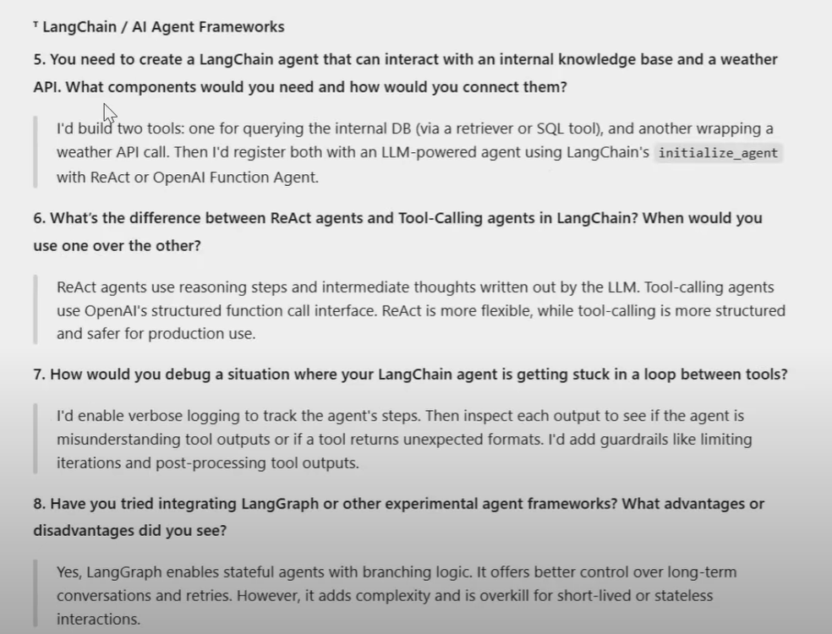

Slide 17
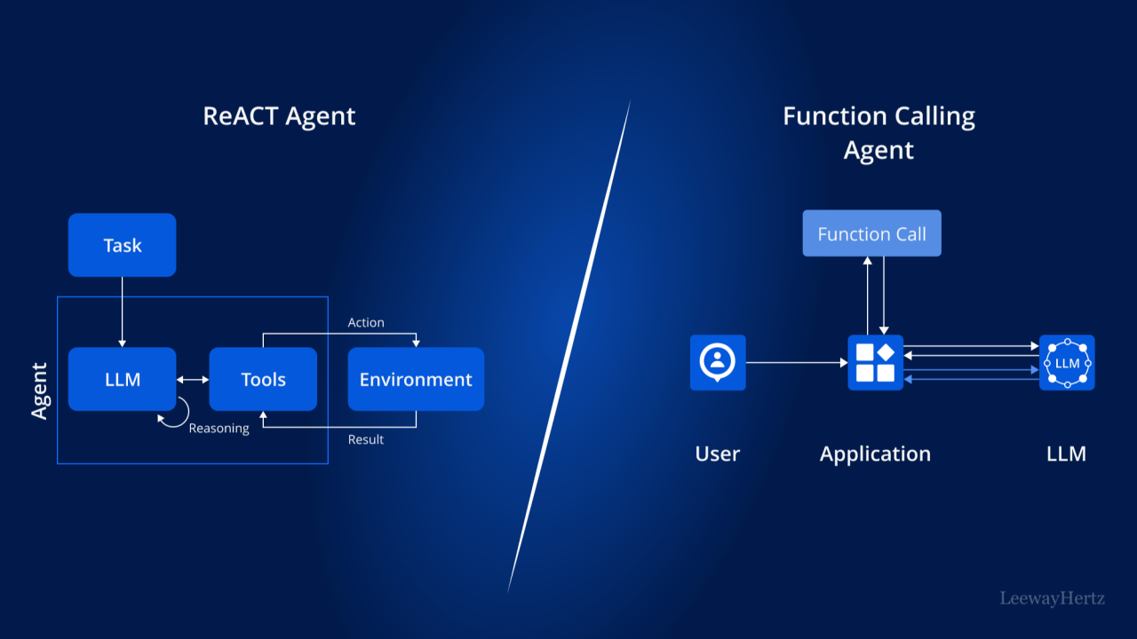
Reasoning and Acting

Slide 18
5. Components for a LangChain agent interacting with an internal knowledge base and a weather API
Original Answer: “I’d build two tools: one for querying the internal DB (via a retriever or SQL tool), and another wrapping a weather API call. Then I’d register both with an LLM‐powered agent using LangChain’s initialize_agent with ReAct or OpenAI Function Agent.”
Evaluation:
✔️ Correct Components: You do need a tool that wraps your internal knowledge‐base queries (e.g., a retriever + vector store or a SQL wrapper) and a separate tool that wraps the weather API.
✔️ Correct Registration Step: Registering both tools with initialize_agent() (choosing either a ReAct‐style agent or a Function‐Calling agent) is exactly how you integrate them.
🔍 Enhancement: You might mention specifics like creating a VectorStoreRetriever (if using embeddings) or a SQLDatabase tool for the internal DB. For the weather API, you would implement a custom Python function that calls the weather endpoint and wraps it in LangChain’s Tool class.
⚠️ Caveat: In some setups, you’ll also need a prompt template that guides the agent on when to call which tool (e.g., instructions for “if user asks about weather, call weather_tool; if user asks about internal docs, call db_tool”).
Conclusion: The answer is fundamentally correct. In a production scenario, you’d simply flesh out the exact retriever or database‐access class and provide a prompt mapping user intents to the appropriate tool.

Slide 19
6. Difference between ReAct agents and Tool‐Calling agents in LangChain
Original Answer: “ReAct agents use reasoning steps and intermediate thoughts written out by the LLM. Tool‐calling agents use OpenAI’s structured function call interface. ReAct is more flexible, while tool‐calling is more structured and safer for production use.”
Evaluation:
✔️ Core Distinction: ReAct interleaves LLM “Thought:” steps and “Action:” steps (calling a tool immediately based on intermediate reasoning). In contrast, Tool-Calling agents simply emit a single JSON-style function call and let your runtime execute it.
✔️ Flexibility vs. Structure: ReAct gives you a transparent chain of reasoning and can choose tools mid‐step. Tool-Calling enforces a strict schema, making input validation and orchestration simpler.
🔍 Additional Detail: You could add that ReAct agents typically run in a single prompt loop (“Thought → Action → Observation → …”) whereas Tool-Calling agents often require at least two turns: LLM emits function_call → runtime executes → LLM ingests result and continues.
⚠️ Caveat: In some versions of LangChain, the boundary blurs because you can combine ReAct‐style chain‐of‐thought prompts with function-calling under the hood. But the high-level distinction remains accurate.
Conclusion: The answer captures the essential difference correctly. A fuller explanation might mention the multi-turn loop for Tool-Calling vs. the single‐turn interleaving for ReAct.

Slide 20
7. Debugging a LangChain agent stuck in a loop between tools
Original Answer: “I’d enable verbose logging to track the agent’s steps. Then inspect each output to see if the agent is misunderstanding tool outputs or if a tool returns unexpected formats. I’d add guardrails like limiting iterations and post‐processing tool outputs.”
Evaluation:
✔️ Verbose Logging: Turning on LangChain’s built-in logging (e.g., setting verbose=True) is the first step so you can see each “Thought → Action → Observation” or each function call.
✔️ Inspect Outputs: Checking whether the agent misinterprets an API response (e.g., wrong JSON schema) is exactly how you identify the loop source.
✔️ Guardrails: Limiting the maximum number of iterations (for ReAct loops) or adding validation/normalization on the tool’s return values prevents infinite circling.
🔍 Additional Tip: You could also add a fallback in your prompt: “If you’ve called the same tool more than X times without progress, stop and ask the user for clarification.” Or use a token‐based stop condition in your chain.
Conclusion: This answer is correct and reflects common debugging practices. It could be expanded with specific LangChain settings (e.g., agent.run(..., max_iterations=3)).

Slide 21
8. Integrating LangGraph or other experimental agent frameworks—advantages and disadvantages
Original Answer: “Yes, LangGraph enables stateful agents with branching logic. It offers better control over long-term conversations and retries. However, it adds complexity and is overkill for short-lived or stateless interactions.”
Evaluation:
✔️ Stateful Agents with Branching Logic: LangGraph (or similar frameworks) indeed gives you a way to represent multi-turn workflows as a directed graph, which allows you to track state, retry paths, and conditional branches.
✔️ Better Control vs. Complexity: Because you’re explicitly defining nodes and edges (state transitions), you get fine-grained control—but you also introduce overhead in designing and maintaining that graph.
🔍 Additional Considerations: You might mention that LangGraph lets you serialize the entire agent state, making it easier to checkpoint or resume long-running tasks. On the flip side, you need to learn a new DSL (domain-specific language) for graph definitions.
⚠️ Caveat: For simple “ask one question, call one tool” workflows, a full graph framework is unnecessary. That said, if you anticipate many dynamic branches (e.g., conditional retries, fallback flows), LangGraph can pay for itself.
Conclusion: The answer is correct. It accurately weighs the benefits of stateful branching against the increased engineering complexity

Slide 22
12. Structuring FastAPI Routes to Expose an LLM Agent as an API
Original Answer: “I’d define a /chat POST endpoint that accepts a JSON payload with user_input, passes it to the LangChain agent, and returns the response. I’d also log errors and handle timeouts.”
Evaluation:
✔️ Correct Core Idea: A single POST endpoint (e.g., /chat) is standard for sending user requests to the agent and returning its reply.
✔️ Accepting JSON & Passing to Agent: Receiving a JSON body with a key like user_input (or message) and forwarding that to the LangChain or custom agent is exactly how you integrate.
✔️ Logging & Timeouts: Mentioning error logging and timeout handling is essential for production reliability.
🔍 Enhancements:
You might also include request/response schemas (Pydantic models) for validation—e.g., python CopyEdit class ChatRequest(BaseModel):
user_input: str
class ChatResponse(BaseModel):
reply: str
If you need to support streaming responses (token-by-token), you could offer an SSE or WebSocket route in addition to /chat.
Consider implementing middleware for rate limiting, authentication, and metrics (Prometheus, OpenTelemetry).
⚠️ Caveat: The answer is minimal but correct; in a real codebase, you’d typically split routes into routers, add dependency injection for the agent, and configure exception handlers.
Conclusion: Fundamentally correct. In practice, you’d flesh it out with Pydantic schemas, dependency injection, and any extra middleware you need.

Slide 23
13. Python Patterns or Design Choices for Managing Asynchronous API Calls and LLM Responses
Original Answer: “I’d use async/await with FastAPI, handle retries with tenacity, and abstract external calls into services or utility classes for testability.”
Evaluation:
✔️ Async/Await with FastAPI: FastAPI is built on Starlette and fully supports async endpoints. Using async def ensures you don’t block the event loop while awaiting LLM calls or external APIs.
✔️ Retries with Tenacity: tenacity is a popular library for retry logic (with exponential backoff, jitter, etc.). Wrapping external HTTP calls or LLM client calls in a @retry decorator is a best practice.
✔️ Abstraction into Services/Utility Classes: Encapsulating external dependencies (e.g., an OpenAI client or an HTTP weather API client) behind a service layer makes your code more modular, easier to mock in tests, and clearer in production.
🔍 Enhancements:
You might also mention using httpx.AsyncClient() (instead of requests) for non-blocking HTTP requests.
Consider using asyncio.wait_for() or FastAPI’s built-in timeout utilities to bound how long you’ll wait for an LLM response.
Leveraging a background task or Celery/RQ for extremely long-running jobs could be relevant if an LLM call might exceed typical HTTP timeouts.
⚠️ Caveat: The answer is solid, but you could also mention circuit breakers (e.g., pybreaker) or bulkhead patterns if your service needs to isolate failures.
Conclusion: Correct and aligned with best practices. Adding specifics about non-blocking HTTP clients, timeouts, and monitoring would make it more complete.

Slide 24
14. Basic Logging Strategy for Tracing Errors in a Multi-Tool AI Agent Pipeline
Original Answer: “I’d log agent steps, tool inputs/outputs, LLM requests/responses, and final outputs. I’d use unique trace IDs per request to trace logs across components.”
Evaluation:
✔️ Logging Agent Steps & Tool Data: Capturing each step—“Thought,” “Action,” “Observation”—or, at minimum, the tool name, its inputs, and outputs, is crucial for diagnosing where an error occurs in a multi-tool chain.
✔️ LLM Requests/Responses: Recording prompts sent to the LLM (or function calls) and the raw responses (or tokens) allows you to debug hallucinations or misinterpretations.
✔️ Final Outputs: Logging the agent’s final decision or answer helps you trace the end‐to‐user result back to the internal steps.
✔️ Unique Trace IDs: Using a request-scoped trace ID (e.g., a UUID generated at the start of /chat) and including it in every log message (across FastAPI, agent logic, tool wrappers, and LLM client) makes it trivial to aggregate logs in a centralized system (ELK, DataDog, etc.).
🔍 Enhancements:
In addition to textual logs, consider structured logging (JSON) so you can query by fields like step="tool_call" or tool_name="weather_api".
Emitting metrics (e.g., histogram of LLM latency, counters for retry attempts) to a monitoring system can complement the logs.
If using OpenTelemetry, you could instrument spans for each tool invocation and LLM call, automatically propagating context.
⚠️ Caveat: The answer is accurate. If you need end‐to‐end distributed tracing (e.g., tracing across multiple microservices), you would also integrate a tracing library.
Conclusion: Correct and covers the essentials. Adding structured logging and metrics/tracing instrumentation would further strengthen the strategy.

Slide 25
15. Documenting Prompt Logic for Team Collaboration
Original Answer: “I maintain a prompt catalog with descriptions, example inputs/outputs, and the goal of each prompt. I version prompts and document changes during testing.”
Evaluation:
✔️ Prompt Catalog: Keeping a centralized “prompt catalog” (e.g., in Markdown, a shared Google Doc, or a wiki) that lists each prompt template, its intended use, and any relevant parameters is a best practice.
✔️ Example Inputs/Outputs: Including concrete examples (both positive and negative cases) helps team members understand edge cases and expected behaviors.
✔️ Goal of Each Prompt: Stating why a prompt exists—e.g., “This prompt’s goal is to instruct the LLM to summarize meeting notes in bullet form”—prevents ad‐hoc modifications that break assumptions.
✔️ Versioning & Change Log: Tracking how prompts evolve (e.g., v1.0 → v1.1 changes) and noting why changes were made (tuning for clarity, avoiding hallucinations) ensures that regressions can be caught quickly.
🔍 Enhancements:
You could integrate prompt templates directly into a code repository (e.g., as Jinja‐style .j2 or .tmpl files) so that prompts can be tested via unit tests.
Using a tool like PromptFlow (or a simple CI check that validates prompt variables) can automate checks that no placeholders are missing.
If you maintain hundreds of prompts, tagging them by domain (e.g., “customer_support,” “product_summary”) can ease navigation.
⚠️ Caveat: The answer is solid; teams sometimes also add comments about which LLM model/version the prompt was tested against (e.g., GPT-4 vs. GPT-3.5).
Conclusion: Correct and reflects industry best practices. Additional automation (CI validation, prompt tests) can further improve collaboration.

Slide 26
16. Debugging a Failing Agent That You Didn’t Build
Original Answer: “First, I read the README and flow diagram. Then I run it with debug logs on to observe step-by-step behavior. I use test inputs to see where it breaks and isolate faulty components.”
Evaluation:
✔️ Reading README & Diagrams: Starting by understanding the documented architecture, dependencies, and overall workflow is essential.
✔️ Running with Debug Logs: Enabling verbose logging (e.g., logging.DEBUG or LangChain’s verbose=True) lets you see the sequence of “Thought → Action → Observation” or function calls, helping pinpoint where errors occur.
✔️ Using Test Inputs to Isolate Failures: Crafting minimal reproducible inputs—such as “Ask the agent to fetch the current weather”—and seeing if it fails on that specific branch is a reliable debugging tactic.
🔍 Enhancements:
You might also step through the code with a debugger (e.g., VS Code’s breakpoint on the agent loop) or insert temporary print/log statements around the suspected failure point.
Checking environment variables, API keys, or configuration mismatches (e.g., wrong model name) is often a quick way to find obvious misconfigurations.
If the agent uses Docker, verifying that all services (e.g., vector store, database) are up and reachable can catch external dependency issues.
⚠️ Caveat: A particularly elusive bug might require adding unit or integration tests around individual tool wrappers (mocking external APIs) to see exactly which part throws an exception.
Conclusion: This is a textbook debugging approach. It’s correct and methodical; you could deepen it by pointing out specific debugging tools or environment checks.

Slide 27
17. Communicating LLM Limitations or Known Bugs to Product Teams or Stakeholders
Original Answer: “I write short memos or tickets with examples of problematic behavior, root cause (if known), and temporary mitigations. I also document known issues in the README or internal wiki.”
Evaluation:
✔️ Short Memos or Tickets with Examples: Providing a minimal working example (e.g., “When the user asks, ‘Summarize my code,’ the LLM often omits private variables”) helps stakeholders reproduce the issue.
✔️ Root Cause (If Known): If you know it’s due to prompt ambiguity or model hallucination, stating that narrows down where the fix needs to occur.
✔️ Temporary Mitigations: Suggesting “Add a sanity check after the LLM call” or “Lower the temperature to 0.2 until a prompt rewrite is complete” shows you’ve thought of a near-term workaround.
✔️ Documenting in README or Wiki: Persisting a “Known Issues” section ensures new team members know about existing limitations—e.g., “This agent cannot reliably extract dates from free‐form text.”
🔍 Enhancements:
You could also include a “Risks & Impact” section in each ticket: how severe is the bug (e.g., “Misleading billing info could cost $10k/month”)?
Periodic stakeholder demos (showing examples of misbehavior and discussing mitigation plans) can help maintain alignment.
If the limitations are model‐specific (e.g., GPT-3.5 fails at reasoning), noting that in the ticket helps future-proof as you upgrade models.
⚠️ Caveat: For high‐priority or compliance‐related issues, you might escalate via a dedicated “triage channel” or slack alert rather than waiting for the next README update.
Conclusion: The approach is correct and aligns with cross-functional communication best practices. Adding a formal “impact assessment” can further clarify urgency and guide prioritization.

